Slide 1
Health Awareness
IST 652 Spring 2021 Final Project
Jiebin Zhu (Alex)

Slide 2

Background
The global pandemic
COVID-19 is still around
So are all the other diseases, pre-pandemic
Goal: Learn a bit more about these other diseases and bring those back to light as well.
Obtained data on
Patients’ Characterstics
Government statics
Centered around: Stroke

Slide 3

Data Source
Kaggle (.csv)
Stroke Prediction Dataset (~ 5000 entries)
Confidential Source (Suspected Real Patient Data)
Credit if used in Research
CDC (.csv)
Stroke Mortality per State
2005, 2014 - 2019

Slide 4
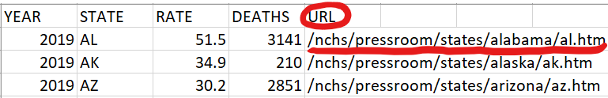
Structured + Semi-Structured Data
CDC Dataset
“https://www.cdc.gov” + “/nchs/pressroom/states/alabama/al.htm”

Slide 5
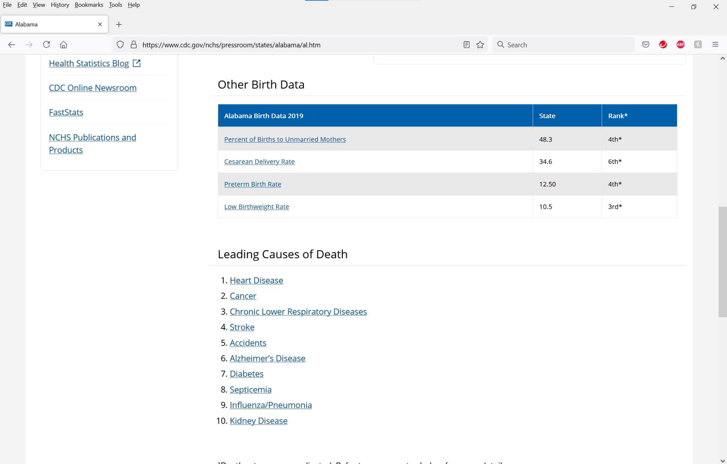

Slide 6
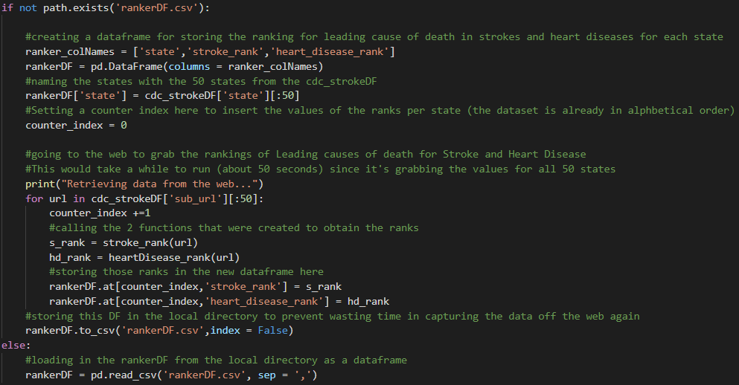

Slide 7


Leading Cause of Death In US- Strokes & Heart Disease
5th
1st

Slide 8
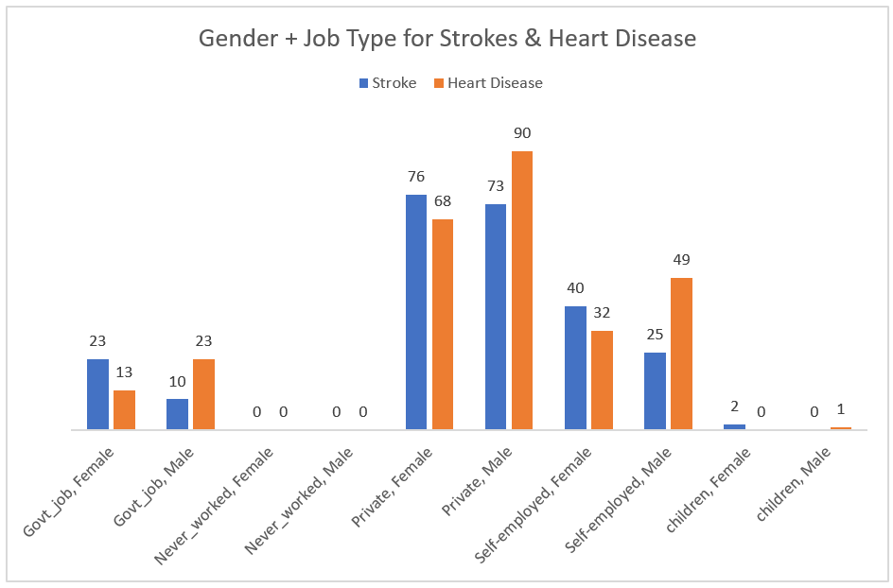
Most common Gender + Job Types for Strokes & Heart Disease?
High Numbers
Private Jobs
Heart Disease - Males
Self employed - Males
Low Numbers
Never Worked
Govt Jobs
Children
Maybe Stress?

Slide 9
Conclusion
Strokes are dangerous and deadly, but more so for Heart Diseases
National Rank# 1: Heart Disease
National Rank# 5: Stroke
People working in private jobs have a higher correlation to getting a stroke and/or heart disease compared to other less stressful job environments like government jobs or never worked before.
Most of us probably fall in the “Private” category…

Slide 10
Conclusion
Remember to take care of your health and yourselves!

